Slide 1
Linear Algebra

Slide 2
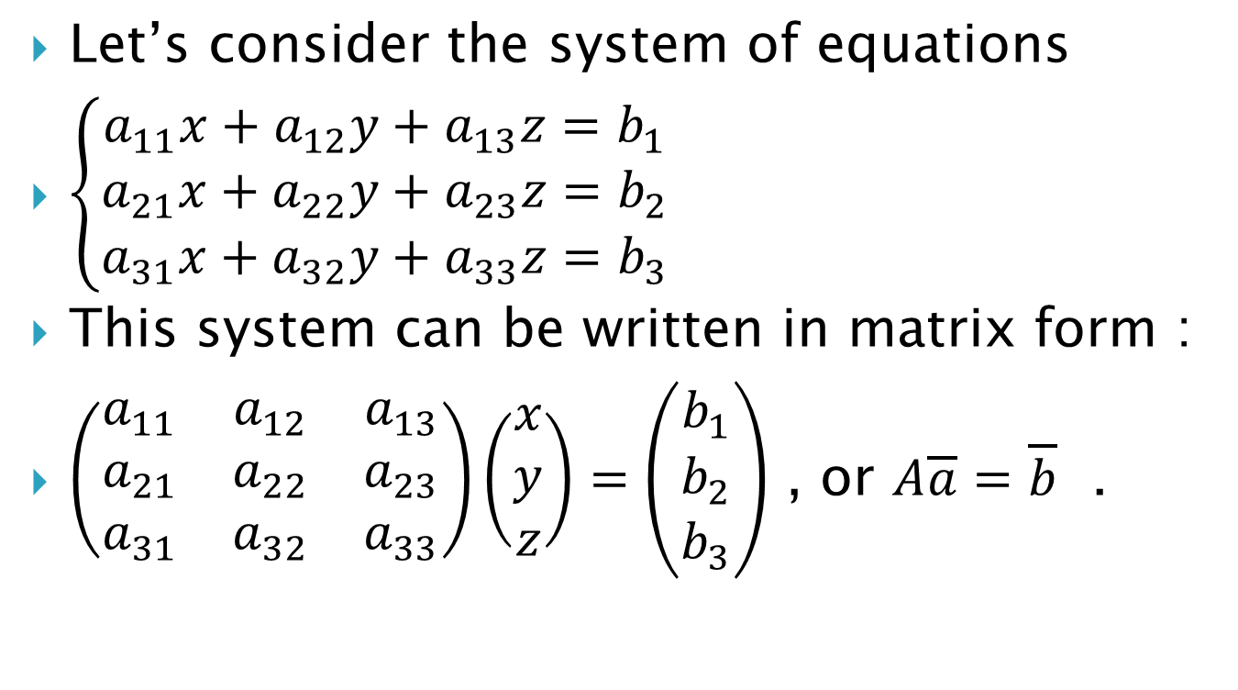
Linear Systems of Equations — Applications
Let’s consider the system of equations
$\left\{\begin{aligned}a_{11}x+a_{12}y+a_{13}z=b_{1} \\ a_{21}x+a_{22}y+a_{23}z=b_{2} \\ a_{31}x+a_{32}y+a_{33}z=b_{3}\end{aligned}\right.$
This system can be written in matrix form :
$\left(\begin{matrix}a_{11} & a_{12} & a_{13} \\ a_{21} & a_{22} & a_{23} \\ a_{31} & a_{32} & a_{33}\end{matrix}\right)\left(\begin{matrix}x \\ y \\ z\end{matrix}\right)=\left(\begin{matrix}b_{1} \\ b_{2} \\ b_{3}\end{matrix}\right)$ , or $A\overline{a}=\overline{b}$ .

Slide 3

Example 1. Write the system of linear equations $\left\{\begin{aligned}−8x−2y−z=5 \\ 3y−4z=−1 \\ −7x−y−2z=4\end{aligned}\right.$
in matrix vector form.

Slide 4
Solving Systems of Linear Equations
Solving $1×1$ systems
Given the numbers $a$ and $b$ , find $x$ such that $ax=b$. Clearly $x=\frac{b}{a}$ if and only if $a≠0$.

Slide 5
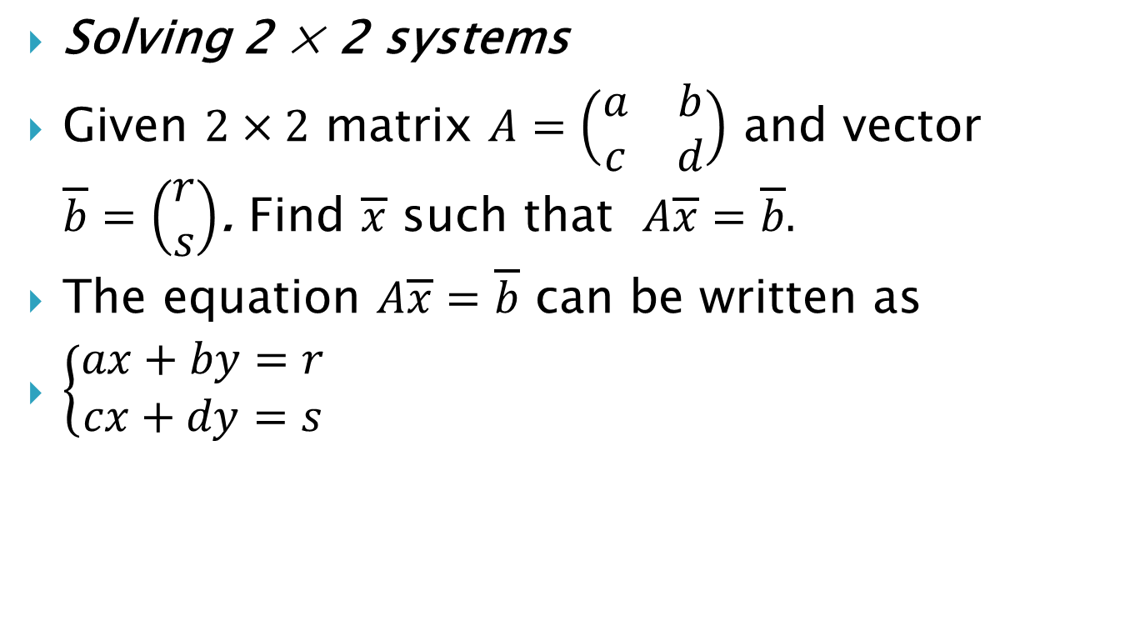
Solving 2 × 2 systems
Given $2×2$ matrix $A=\left(\begin{matrix}a & b \\ c & d\end{matrix}\right)$ and vector $\overline{b}=\left(\begin{matrix}r \\ s\end{matrix}\right)$. Find $\overline{x}$ such that $A\overline{x}=\overline{b}.$
The equation $A\overline{x}=\overline{b}$ can be written as
$\left\{\begin{aligned}ax+by=r \\ cx+dy=s\end{aligned}\right.$

Slide 6
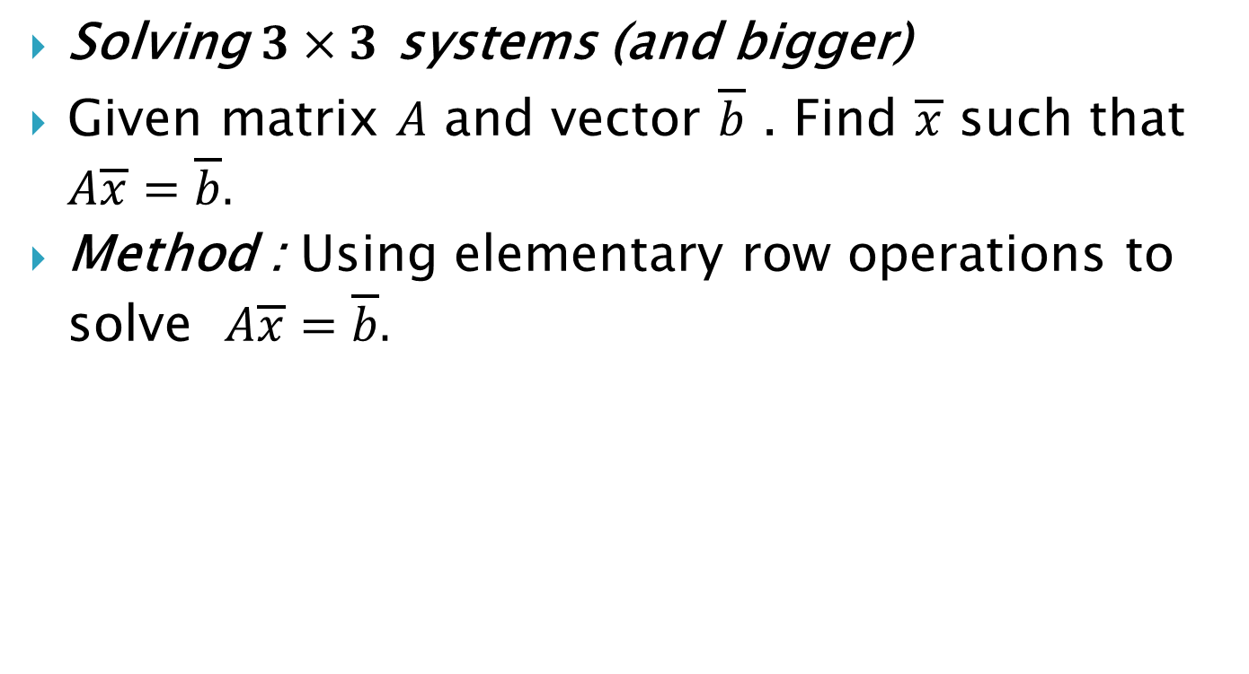
Solving $3×3$ systems (and bigger)
Given matrix $A$ and vector $\overline{b}$ . Find $\overline{x}$ such that $A\overline{x}=\overline{b}.$
Method : Using elementary row operations to solve $A\overline{x}=\overline{b}.$

Slide 7
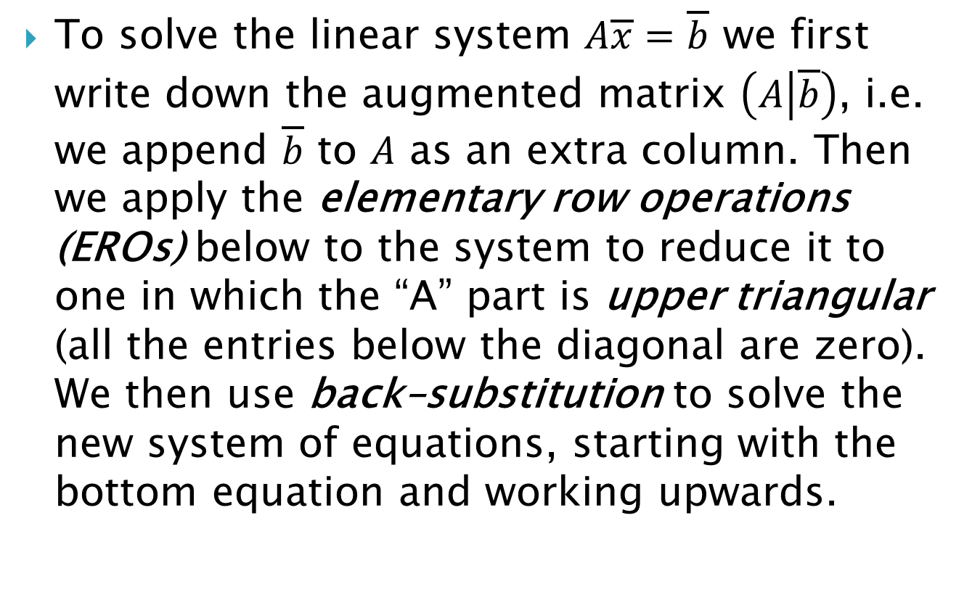
To solve the linear system $A\overline{x}=\overline{b}$ we first write down the augmented matrix $\left(A | \overline{b}\right)$, i.e. we append $\overline{b}$ to $A$ as an extra column. Then we apply the elementary row operations (EROs) below to the system to reduce it to one in which the “A” part is upper triangular (all the entries below the diagonal are zero). We then use back–substitution to solve the new system of equations, starting with the bottom equation and working upwards.

Slide 8
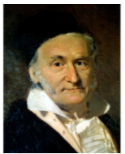
Gauss Elimination method
To efficiently solve a system of linear equations first construct an augmented matrix. Then apply the appropriate elementary row operations to obtain an augmented matrix in upper triangular form. In this form, the equivalent linear system can easily be solved using back substitution. This process is called Gaussian elimination, named in honor of Carl Friedrich Gauss

Slide 9
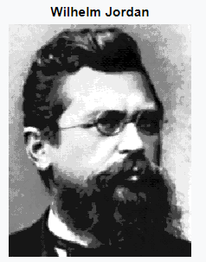
Gauss-Jordan method starts out with an augmented matrix, and by a series of row operations ends up with a matrix that is in the reduced row echelon form.
A matrix is in the reduced row echelon form if the first nonzero entry in each row is a 1, and the columns containing these 1's have all other entries as zeros. The reduced row echelon form also requires that the leading entry in each row be to the right of the leading entry in the row above it, and the rows containing all zeros be moved down to the bottom.

Slide 10
Gauss-Jordan Method
Write the augmented matrix.
Interchange rows if necessary to obtain a non-zero number in the first row, first column.
Use a row operation to get a 1 as the entry in the first row and first column.
Use row operations to make all other entries as zeros in column one.
Interchange rows if necessary to obtain a nonzero number in the second row, second column. Use a row operation to make this entry 1. Use row operations to make all other entries as zeros in column two.
Repeat the same steps for row 3, column 3. Continue moving along the main diagonal until you reach the last row, or until the number is zero.
The final matrix is called the reduced row-echelon form.

Slide 11
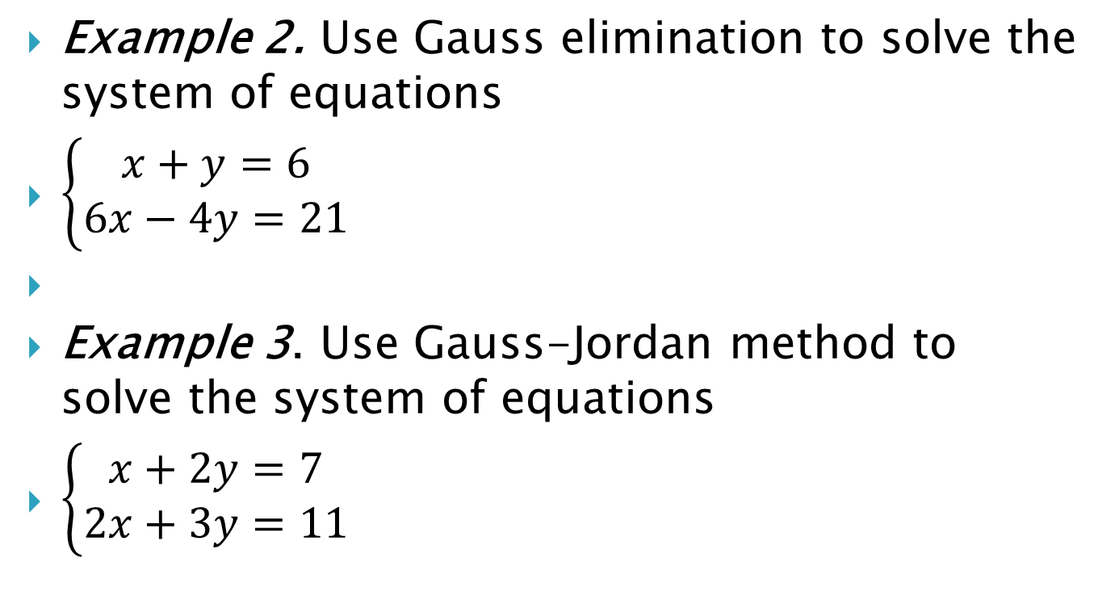
Example 2. Use Gauss elimination to solve the system of equations
$\left\{\begin{aligned}x+y=6 \\ 6x−4y=21\end{aligned}\right.$
Example 3. Use Gauss-Jordan method to solve the system of equations
$\left\{\begin{aligned}x+2y=7 \\ 2x+3y=11\end{aligned}\right.$

Slide 12

Example 4. Use Gaussian elimination to solve the following system of linear equations
$\left\{\begin{aligned}2x+y−2z=10 \\ 3x+2y+2z=1 \\ 5x+4y+3z=4\end{aligned}\right.$

Slide 13

Example 5. Use Gauss-Jordan method to solve the system of equations
$\left\{\begin{aligned}2x+y+2z=10 \\ x+2y+z=8 \\ 3x+y−z=2\end{aligned}\right.$

Slide 14
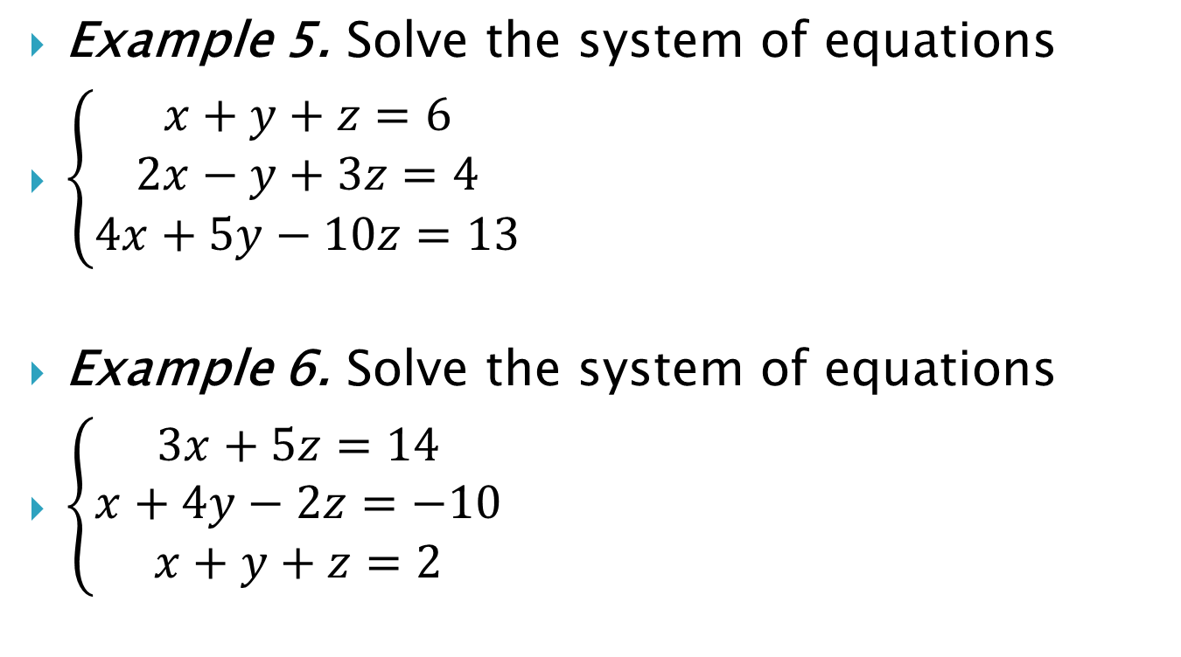
Example 5. Solve the system of equations
$\left\{\begin{aligned}x+y+z=6 \\ 2x−y+3z=4 \\ 4x+5y−10z=13\end{aligned}\right.$
Example 6. Solve the system of equations
$\left\{\begin{aligned}3x+5z=14 \\ x+4y−2z=−10 \\ x+y+z=2\end{aligned}\right.$

Slide 15
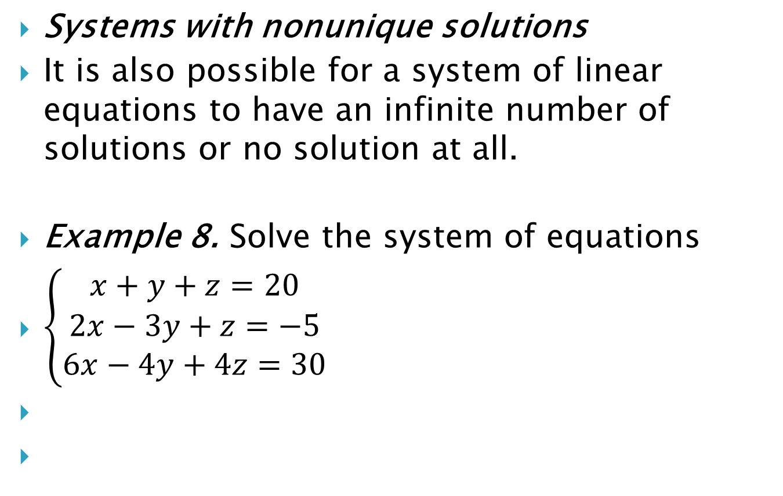
Systems with nonunique solutions
It is also possible for a system of linear equations to have an infinite number of solutions or no solution at all.
Example 8. Solve the system of equations
$\left\{\begin{aligned}x+y+z=20 \\ 2x−3y+z=−5 \\ 6x−4y+4z=30\end{aligned}\right.$

Slide 16
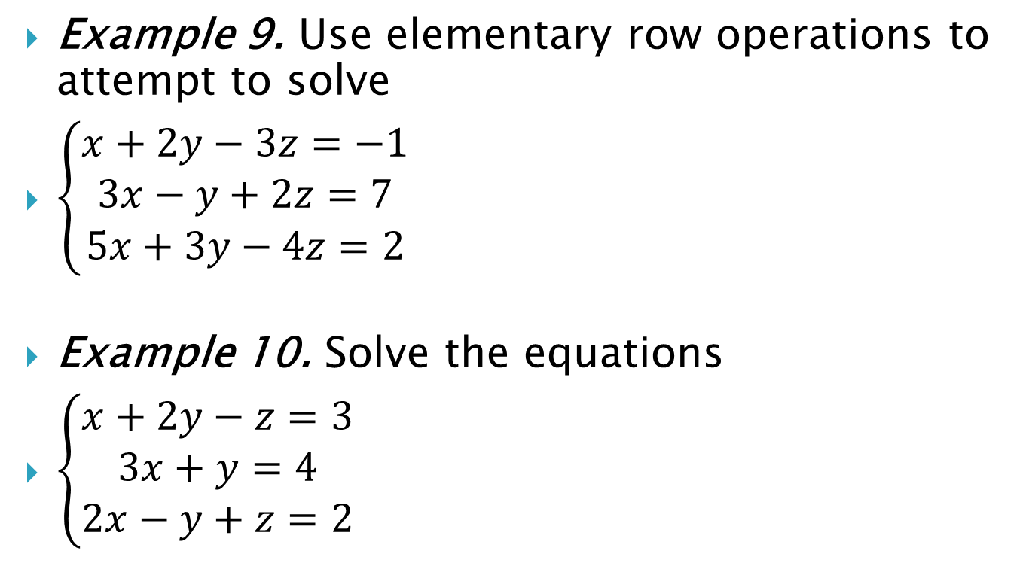
Example 9. Use elementary row operations to attempt to solve
$\left\{\begin{aligned}x+2y−3z=−1 \\ 3x−y+2z=7 \\ 5x+3y−4z=2\end{aligned}\right.$
Example 10. Solve the equations
$\left\{\begin{aligned}x+2y−z=3 \\ 3x+y=4 \\ 2x−y+z=2\end{aligned}\right.$

Slide 17
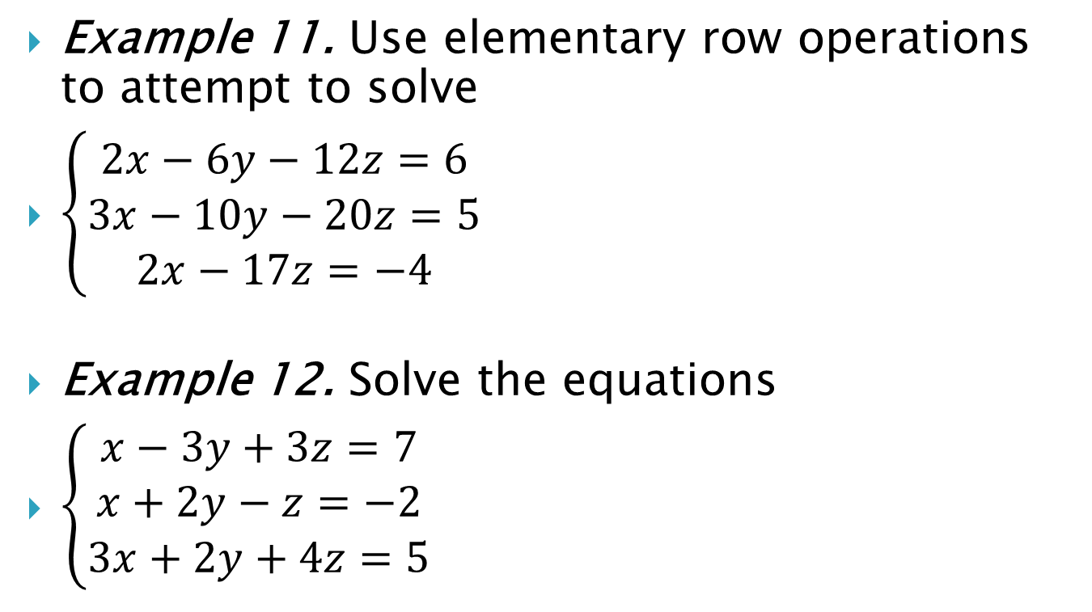
Example 11. Use elementary row operations to attempt to solve
$\left\{\begin{aligned}2x−6y−12z=6 \\ 3x−10y−20z=5 \\ 2x−17z=−4\end{aligned}\right.$
Example 12. Solve the equations
$\left\{\begin{aligned}x−3y+3z=7 \\ x+2y−z=−2 \\ 3x+2y+4z=5\end{aligned}\right.$

Slide 18
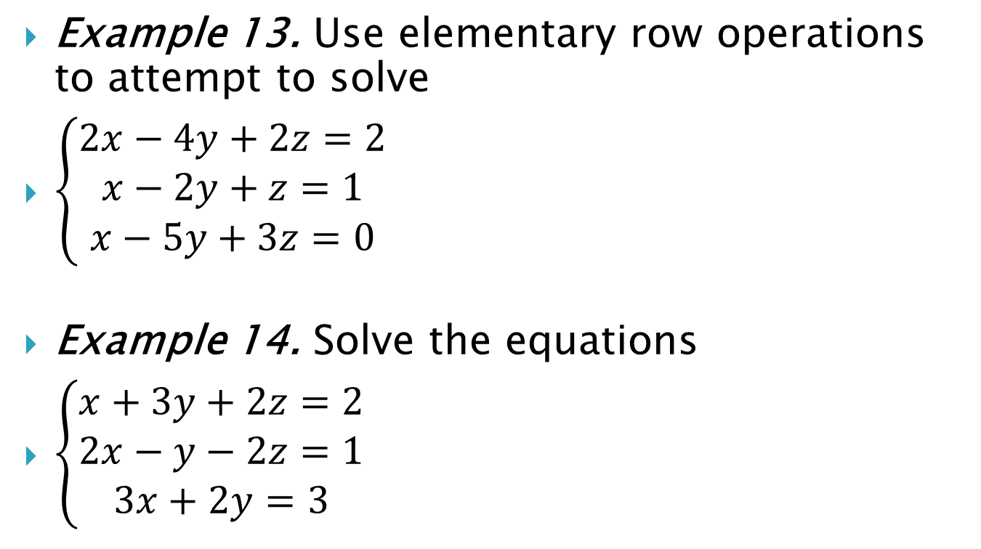
Example 13. Use elementary row operations to attempt to solve
$\left\{\begin{aligned}2x−4y+2z=2 \\ x−2y+z=1 \\ x−5y+3z=0\end{aligned}\right.$
Example 14. Solve the equations
$\left\{\begin{aligned}x+3y+2z=2 \\ 2x−y−2z=1 \\ 3x+2y=3\end{aligned}\right.$

